Slide 1



Next Generation AI for Document Automation – Accounts Payable
Weekly Report CW
#placeholder
January 2024

Slide 2


Slide 3
Agenda
RAID (Risks, Actions, Issues & Decisions) Follow-up
Project Status & Timeline Review
Highlight Topics

Slide 4
Risks – Focus on Open / In Response
RAID (Risks, Actions, Issues & Decisions) Follow-up
Status | Open at | Id | Description | Priority | Action Id | Action Description | Action Responsible | Action Status

Slide 5
Issues
RAID (Risks, Actions, Issues & Decisions) Follow-up
Status | Opened at | Closed at | Id | Description | Priority | Risk Id | Risk Description | Action Id | Action Description | Action Status

Slide 6
Decisions
RAID (Risks, Actions, Issues & Decisions) Follow-up
Id | Decision Detail | Decision Impact | Decision Date | Proposed by | Approved by | Alternatives Considered
D001​
D002​
D003​
D004​

Slide 7
Agenda
RAID (Risks, Actions, Issues & Decisions) Follow-up
Project Status & Timeline Review
Highlight Topics

Slide 8


Projects Status & Timeline Review
Weekly Report –
#CWPlaceHolder
-
Achievements
Next Steps

Slide 9
Kärcher – Interim Phase Plan
Workstream Lead:
KAR
EY
HY
March
April
May
June
Jul
Deliverables
10
11
12
13
14
15
16
17
18
19
20
21
22
23
24
25
26
27
KAR Lead
EY / HY Lead
PMO-Service
Manuel
Sefa / Michael
Design Workshops
Kathrin / Hannah
Michael / Lynn
Data Acquisition
Manuel / Yannick
Denis
Email-Service
Manuel
Elena
Document Classification
Kathrin / Antonina / Tim /
Hannah / Raluca
Lynn / Junior
Information Extraction
Hannah / Antonina
Lynn / Junior
Pre-Set Agent
Hannah / Antonina
Lynn / Junior
Customization Agent
Hannah / Antonina
Lynn / Junior
Optimization Agent
Hannah / Antonina
Lynn / Junior
Document Validation
Hannah / Manuel
Lynn / Junior
Document Rejection
Manuel / Kathrin
Lynn / Elena
Field – Level Translation
Hannah / Manuel
Lynn / Junior
Master Data Enrichment (header)
Hannah
COE / Hugo
Master Data Enrichment (line item)
Hannah
COE / Hugo
Attribute Prediction
Hannah / Manuel
Lynn / Hugo
Pre-Set Prediction
Hannah / Manuel
Lynn / Hugo
Optimization Prediction
Hannah / Manuel
Lynn / Junior
SAP Connector
Manuel
Denis
Testing
Manuel
Lynn / Junior
Test Cases
Manuel
Lynn / Junior
Test Execution
Manuel
Lynn / Junior
Reporting & Monitoring
Tim
Michael / CSRV
Hypercare
Manuel
Lynn / Junior
Training
Antonina
Lynn
Roll-out Planning
Kathrin / Manuel
Lynn / Michael

Slide 10
Agenda
RAID (Risks, Actions, Issues & Decisions) Follow-up
Project Status & Timeline Review
Highlight Topics

Slide 11
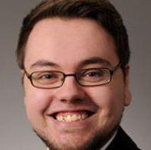
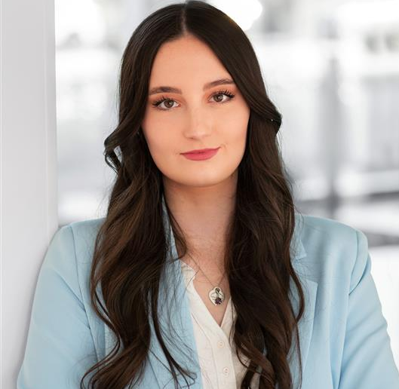
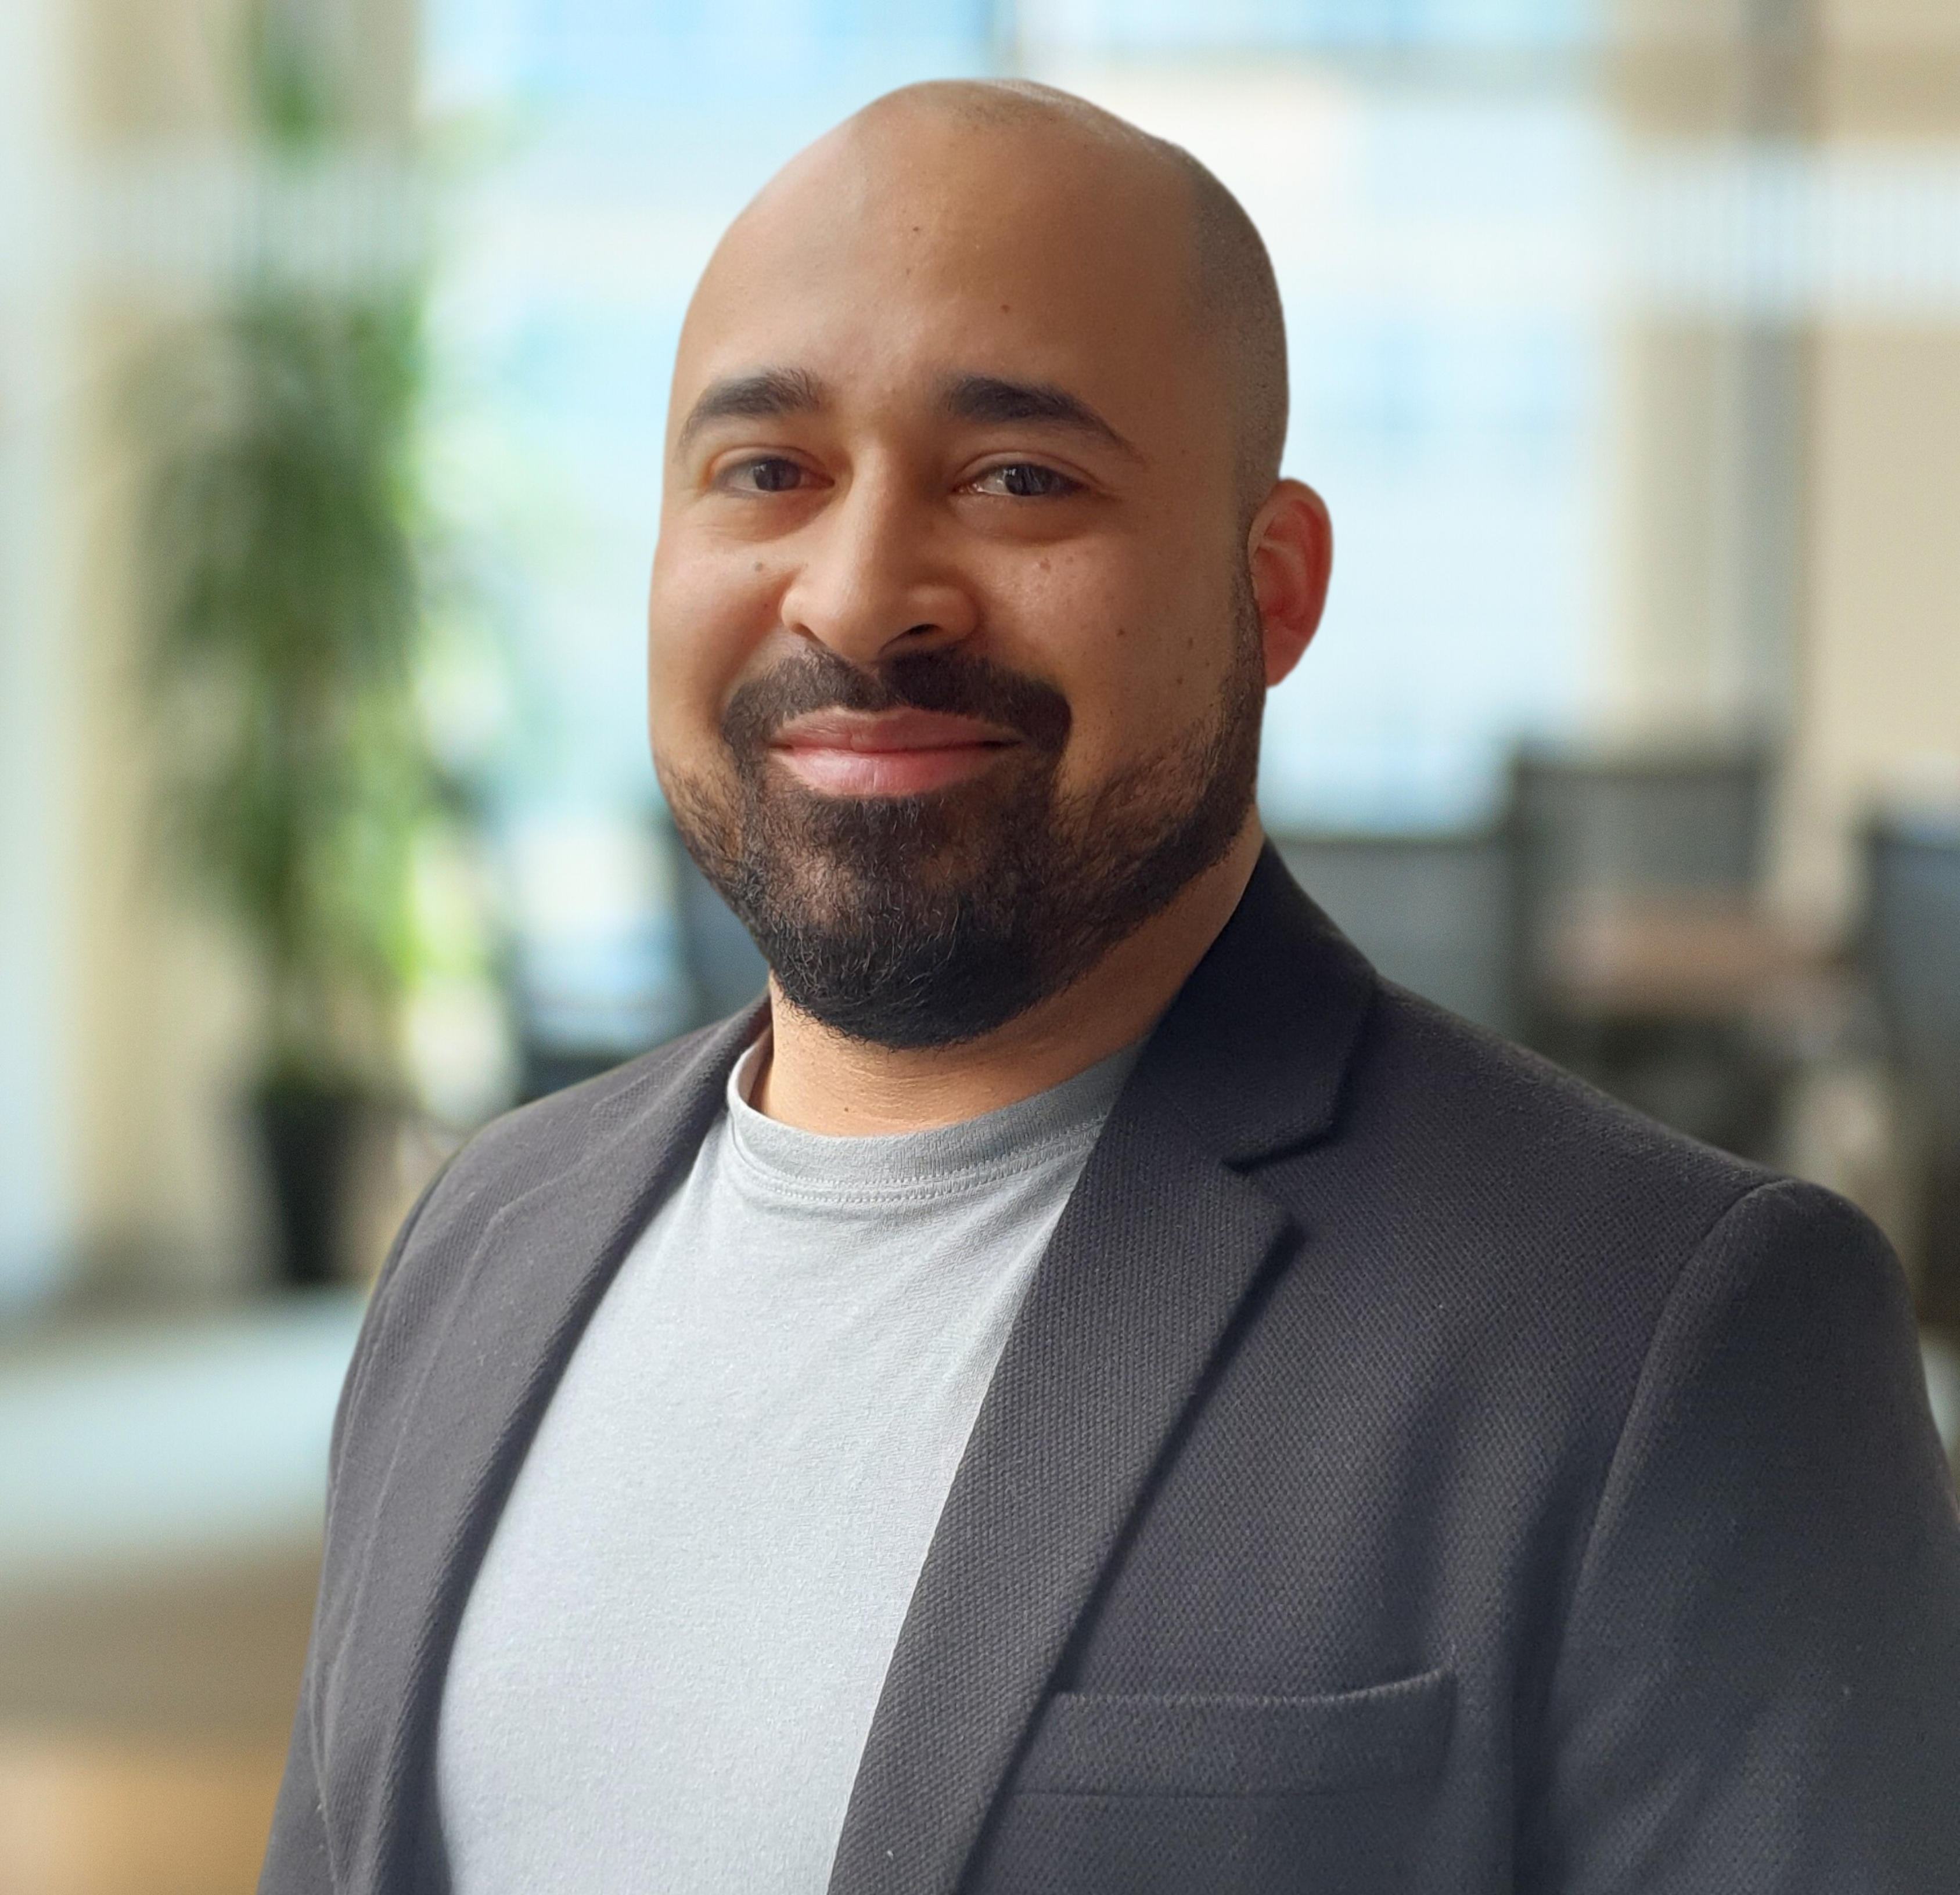
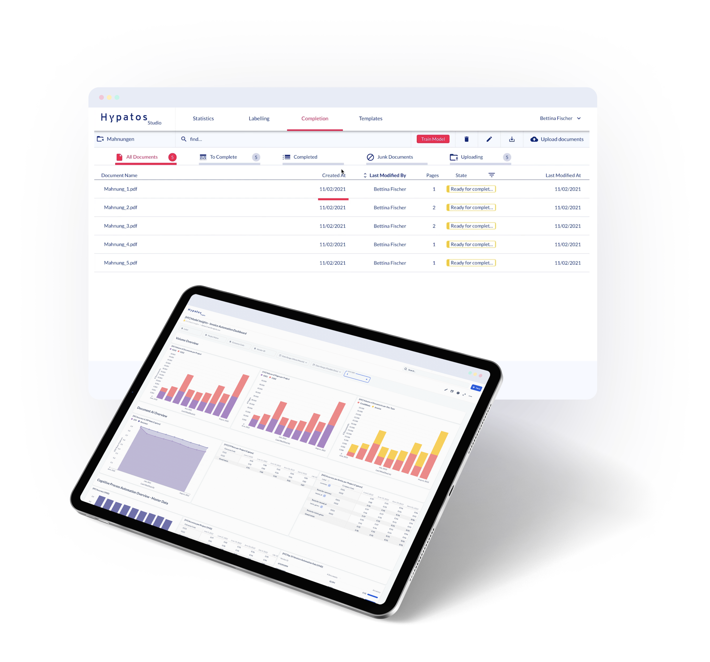
Thank you
Michael Schütz
Project Manager
Michael.Schuetz@de.ey.com
+49 (0) 160 939 22494
Lynn Fiedler
CoE & Accounts Payable Expert
Lynn.Fiedler@de.ey.com
+49 (0) 160 939 29898
Junior Alexis Perez Mendez
CoE & Accounts Payable Expert
Junior.Alexis.Perez.Mendez@de.ey.com+49 (0) 160 939 13951

